Slide 1
PCWG Analysis Tool
Peter Stuart
September 15, 2015

Slide 2
Presentation Contents
This presentation details the structure of PCWG Tool Analysis and Dataset configuration files
Configuration files are written in XML format (eXtensible Markup Language)
Configuration files can also be edited with the PCWG Tool GUI (note: some advanced features currently only supported by editing xml directly)

Slide 3
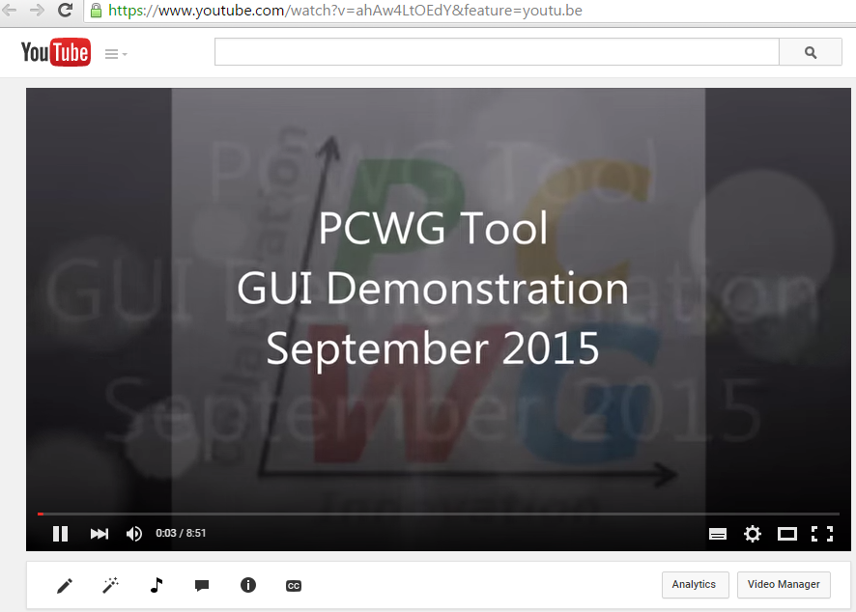
Screencast Demo
Screen Cast accessed via www.pcwg.org > Analysis Tool > Screen Cast

Slide 4
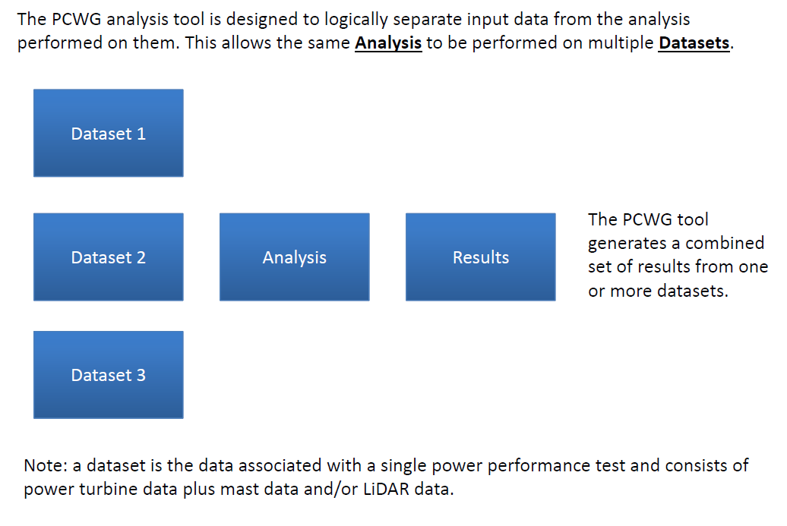
Key PCWG Tool Concept: Dataset and Analysis

Slide 5
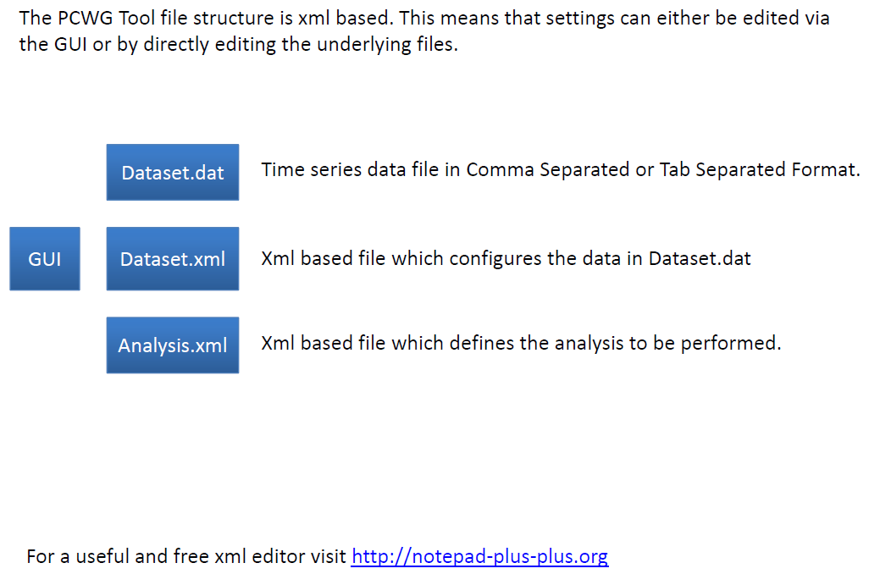
File Structure and GUI (1)

Slide 6
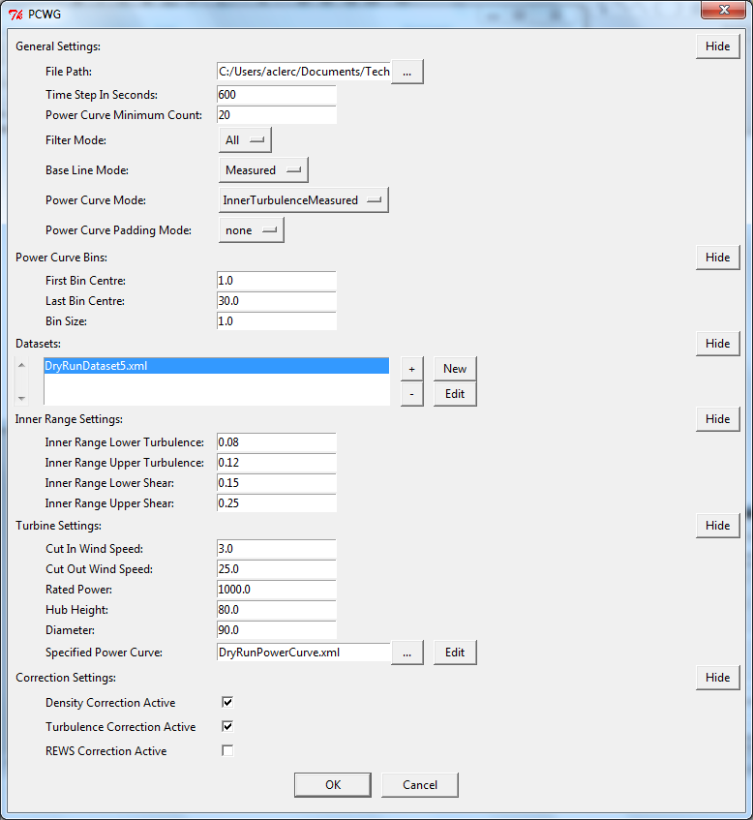
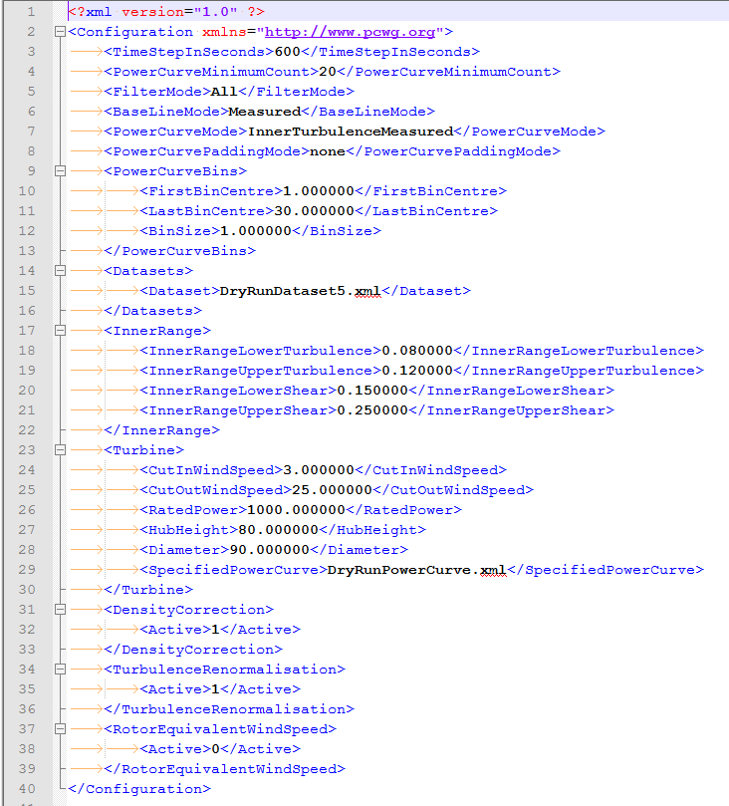
File Structure and GUI (2)
Analysis xml Config File
Analysis GUI Editor

Slide 7
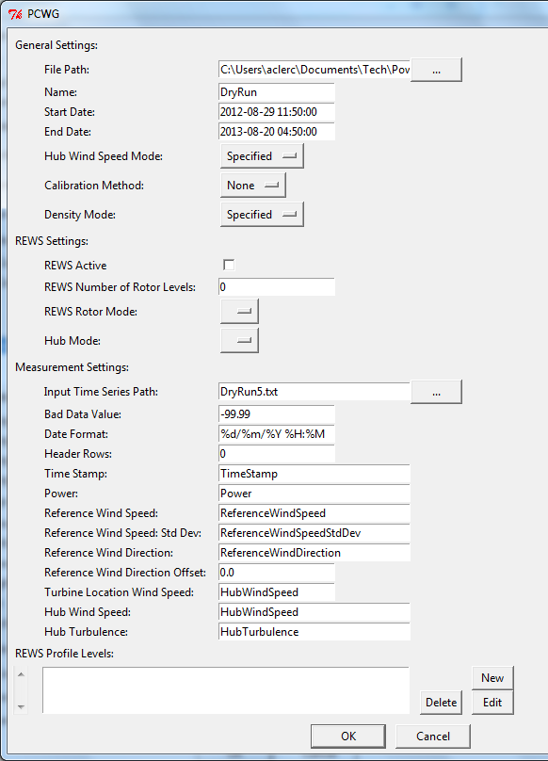
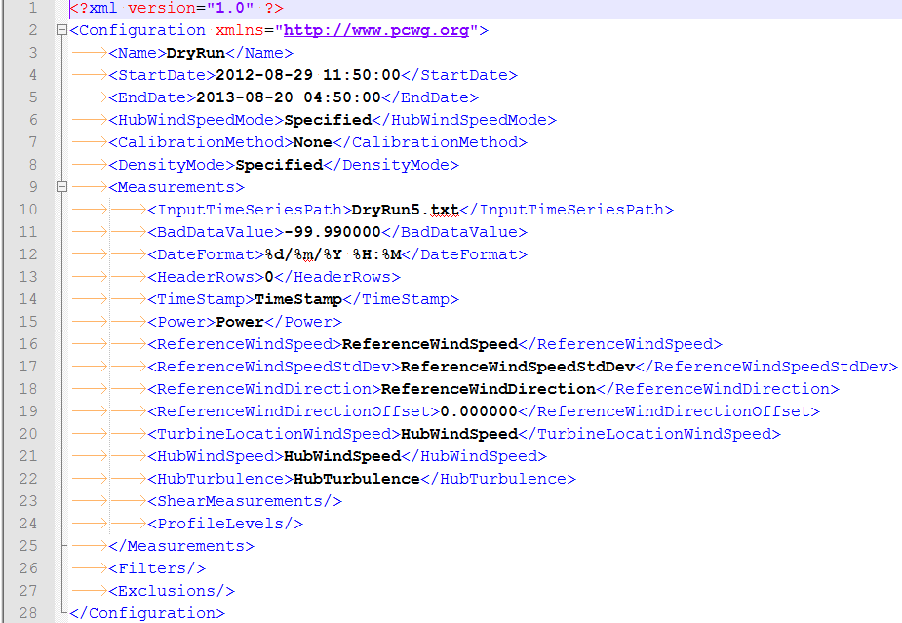
File Structure and GUI (3)
Dataset xml Config File
Dataset GUI Editor

